Slide 1







LEARNING PYTHON?
Pologon, Angela Mae E. 安希佐 4110E229

Slide 2


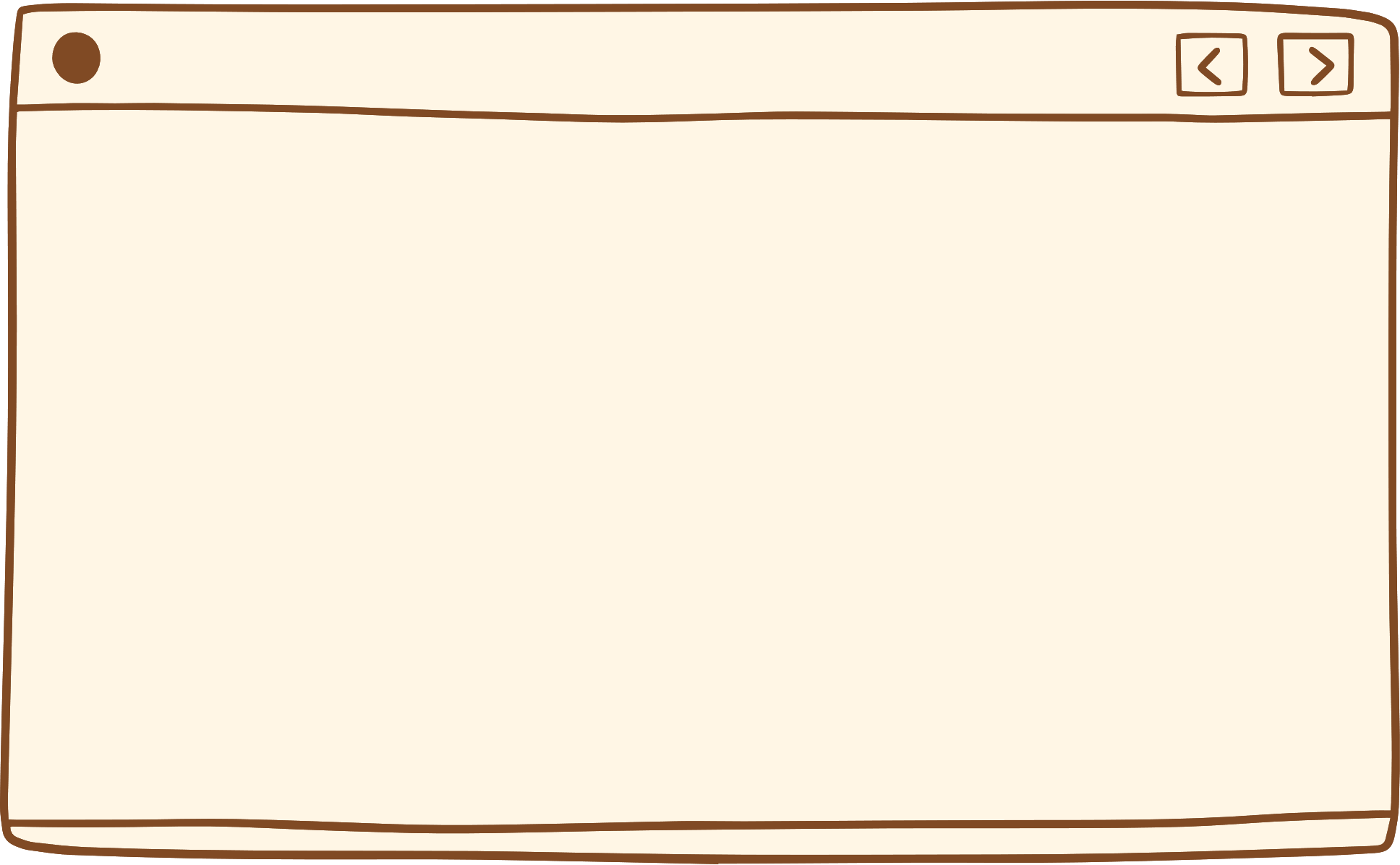




A popular programming language.
created by Guido van Rossum
released in 1991
web development (server-side)
software development,
mathematics,
system scripting.
What is Python?

Slide 3


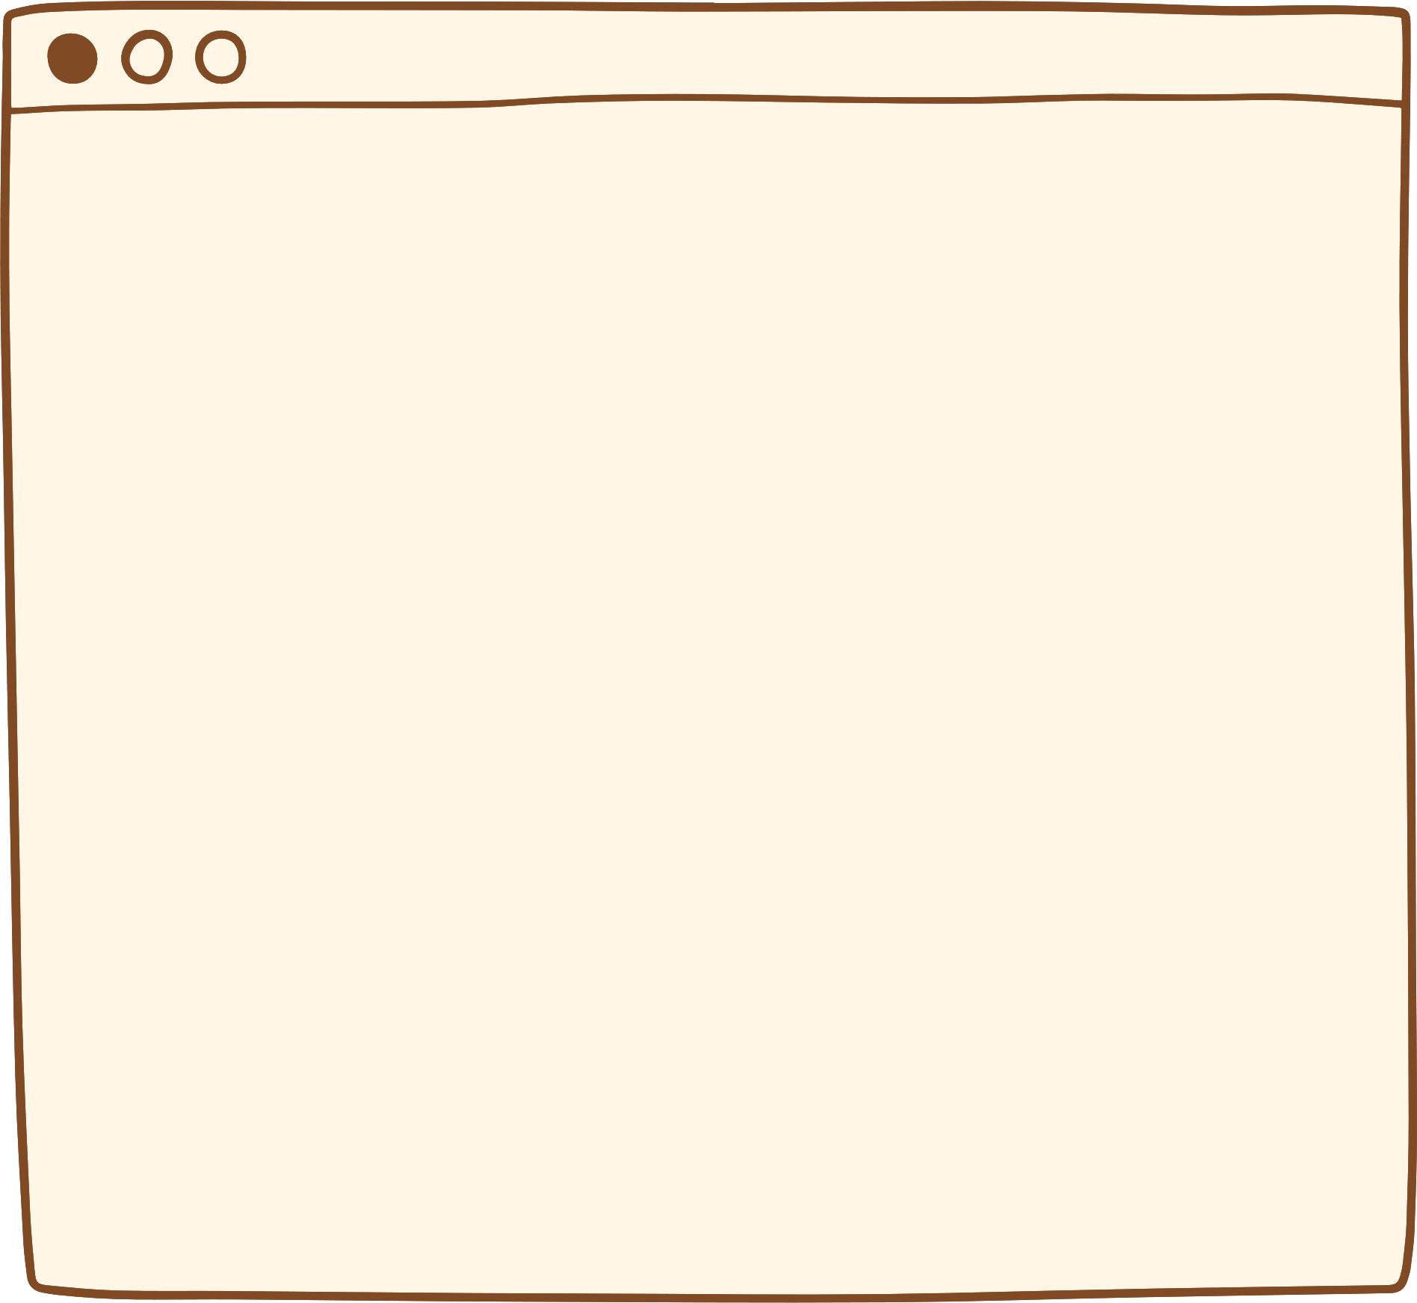



WHY TO LEARN PYTHON?
Possible to write Python in an Integrated Development Environment, such as Thonny, Pycharm, Netbeans or Eclipse which are particularly useful when managing larger collections of Python files.
was designed for readability, and has some similarities to the English language with influence from mathematics.
uses new lines to complete a command, as opposed to other programming languages which often use semicolons or parentheses
relies on indentation, using whitespace, to define scope; such as the scope of loops, functions and classes. Other programming languages often use curly-brackets for this purpose.
works on different platforms (Windows, Mac, Linux, Raspberry Pi, etc).
has a simple syntax similar to the English language.
has syntax that allows developers to write programs with fewer lines than some other programming languages.
runs on an interpreter system, meaning that code can be executed as soon as it is written. This means that prototyping can be very quick.
can be treated in a procedural way, an object-oriented way or a functional way.

Slide 4



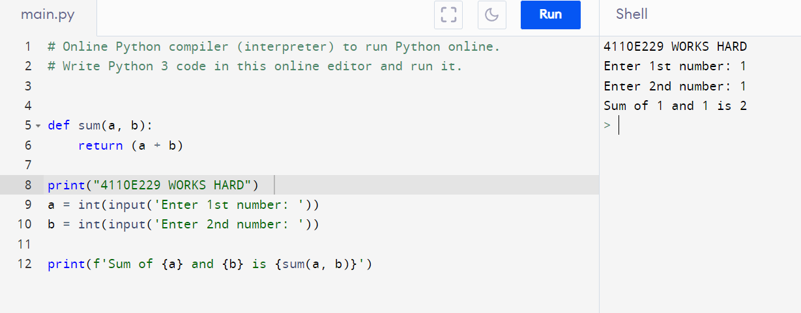

Python Online Interpreter No. 01

Slide 5




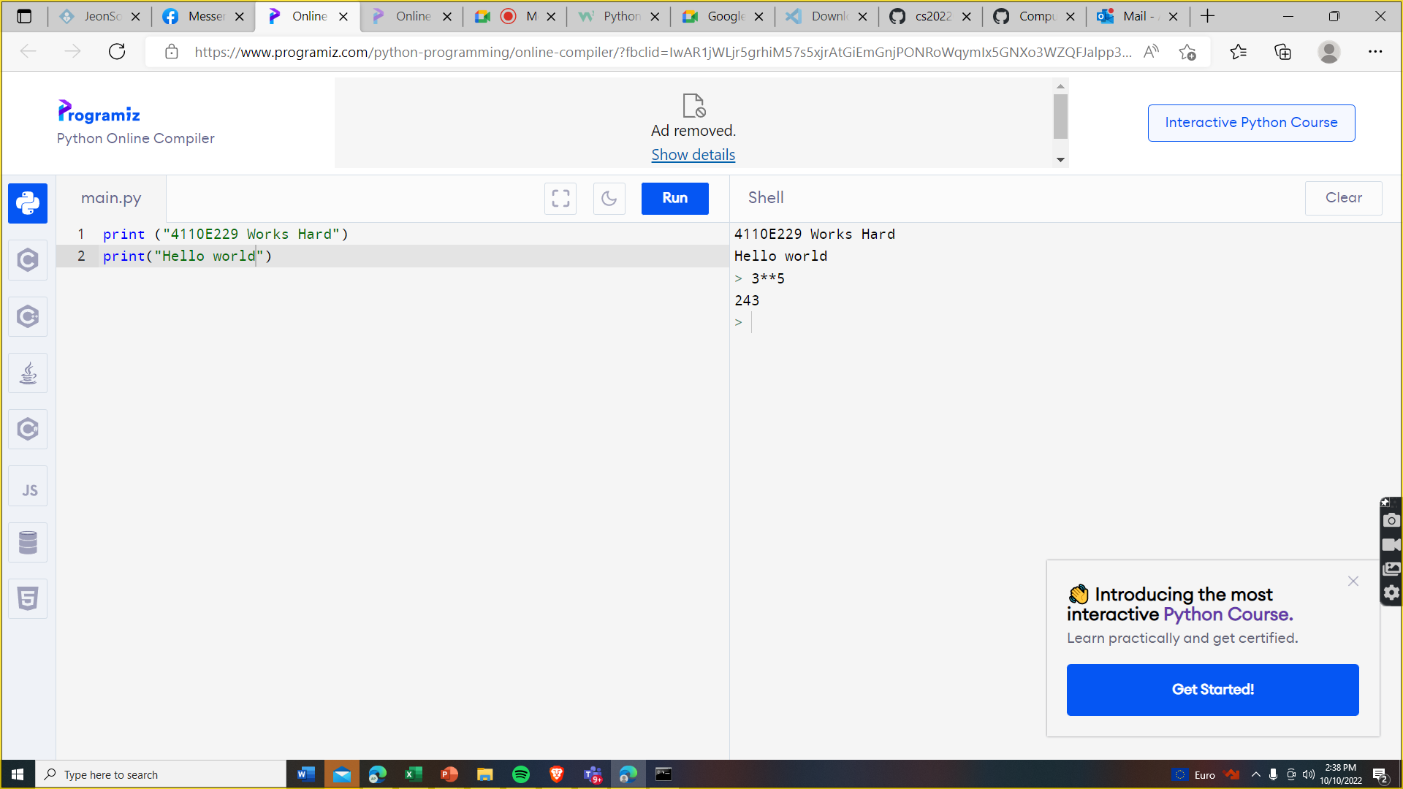

Python Online Interpreter No. 02
INTERACTIVE

Slide 6



INPUT
&
OUTPUT

Slide 7



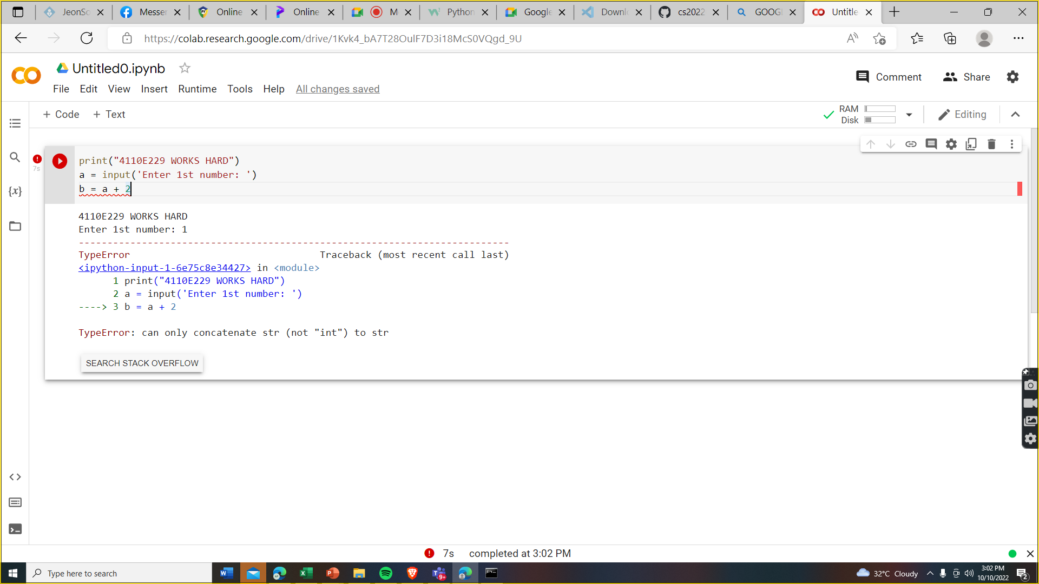

QUESTION?
Data Type

Slide 8

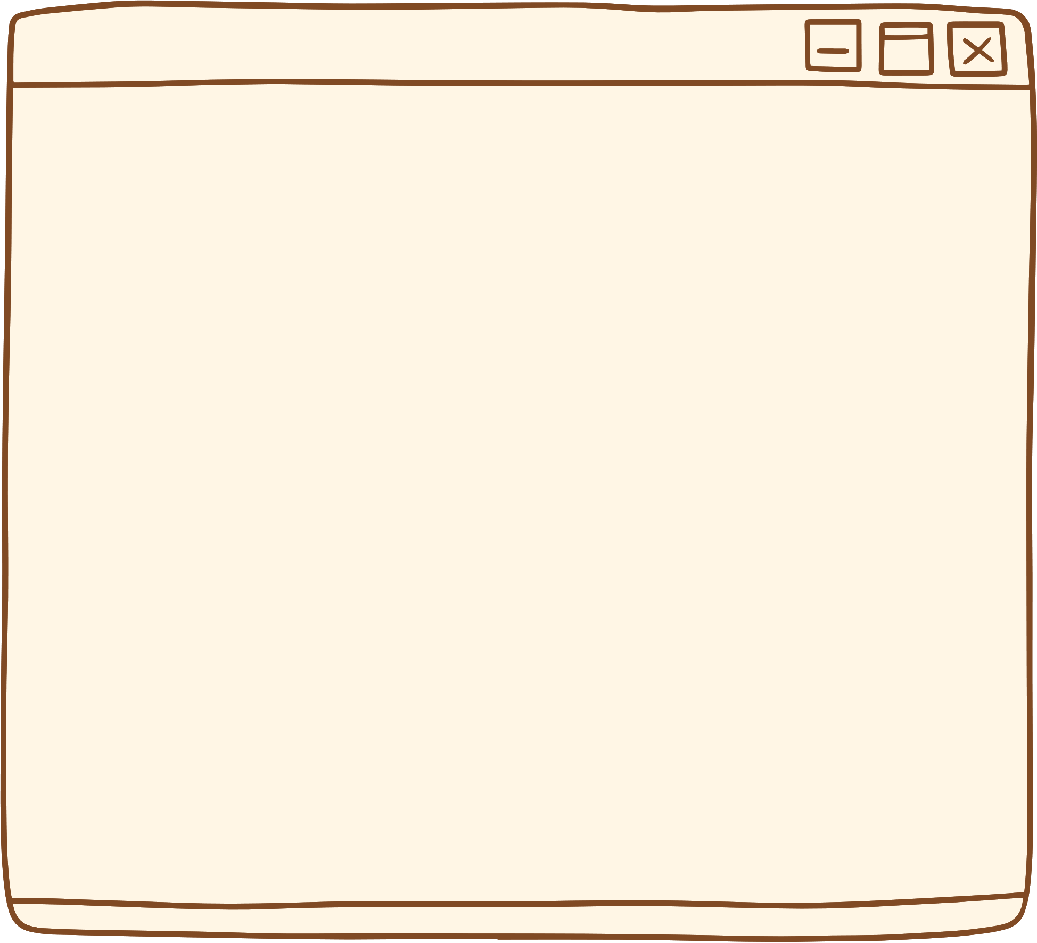
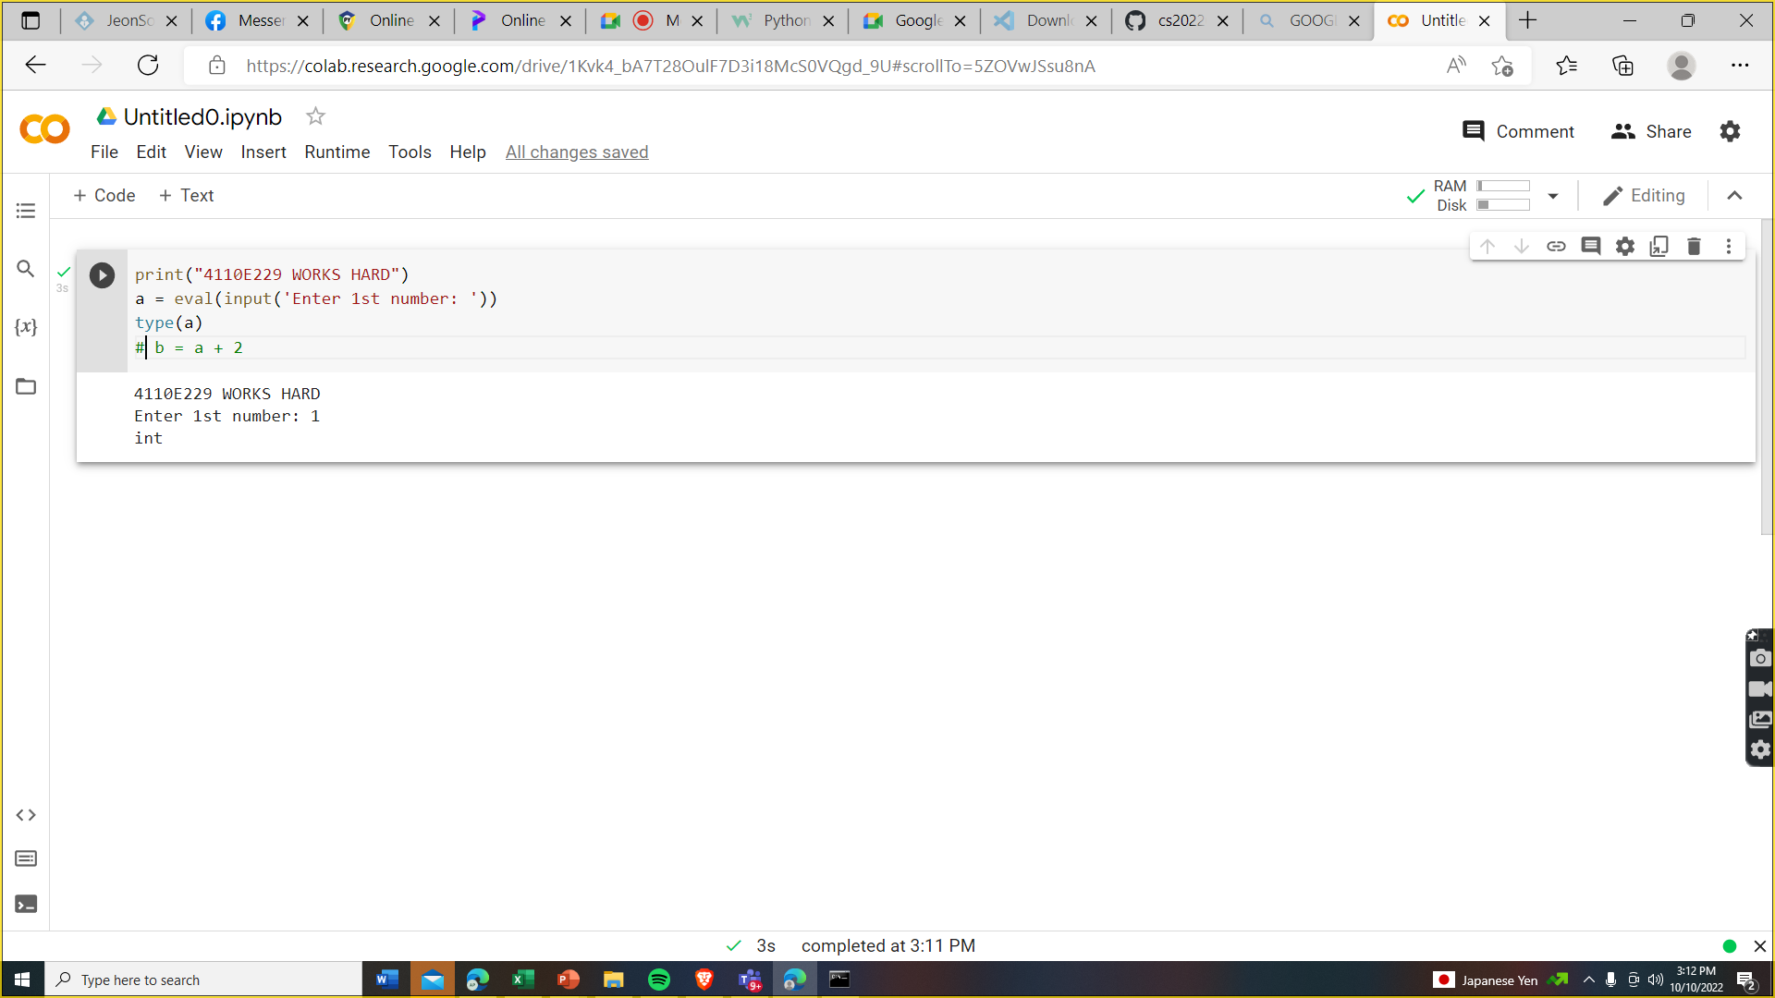
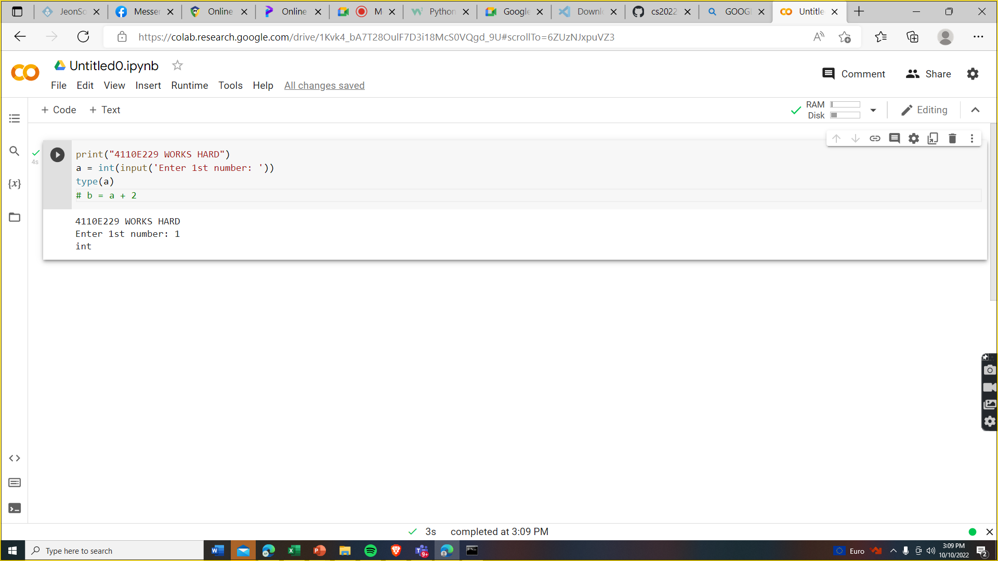

Steps:
POINT 2
POINT 1

Slide 9




Answer 1:
Answer 2:

Slide 10


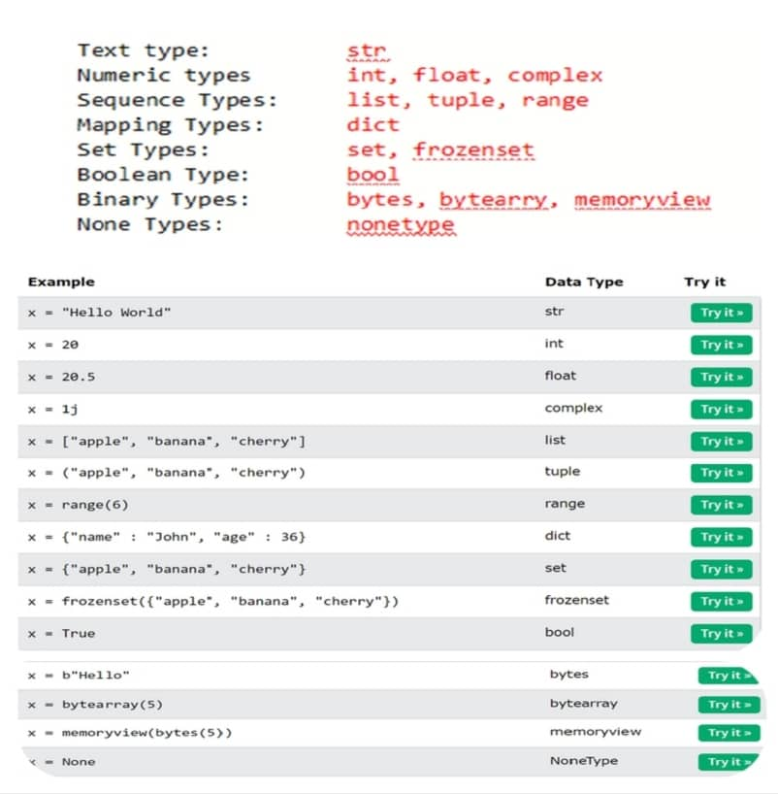

DATA TYPES
In programming, data type is an important concept.
Variables can store data of different types, and different types can do different things.
Python has the following data types built-in by default,
Python Data Types

Slide 11



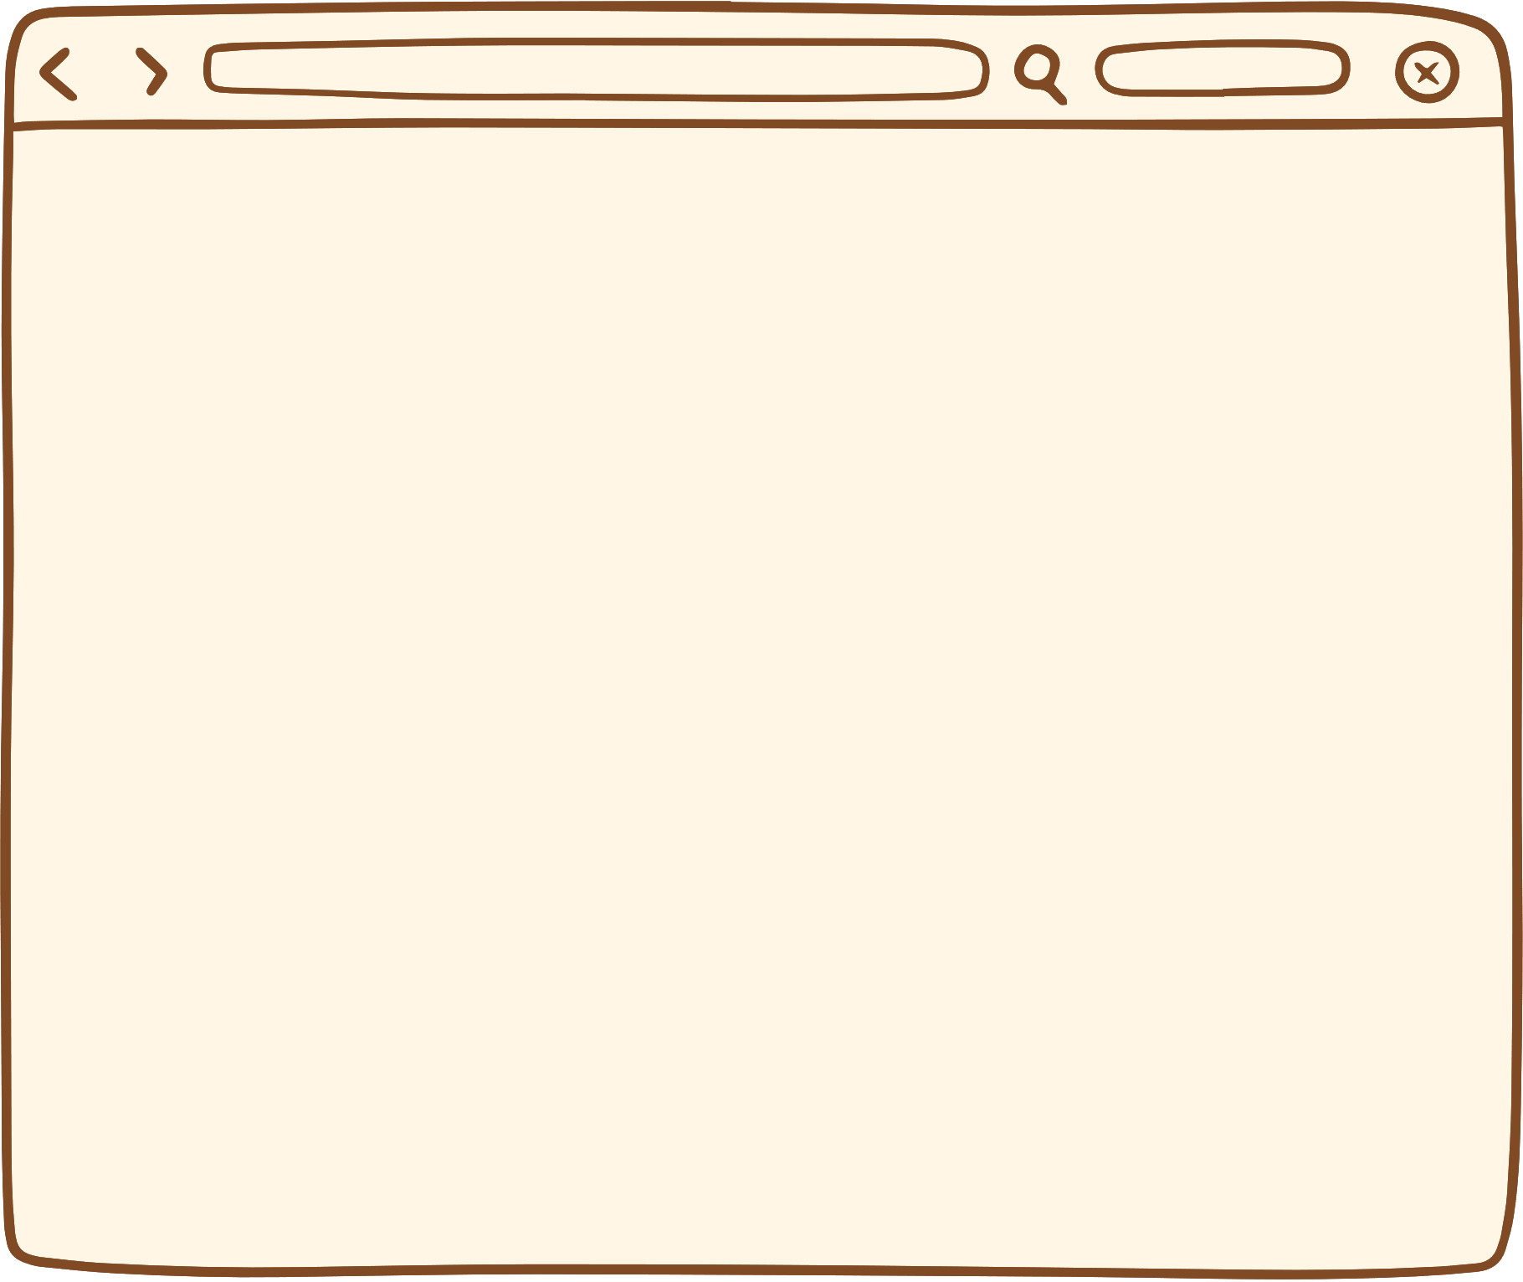


SETTING THE SPECIFIC DATA TYPE

Slide 12
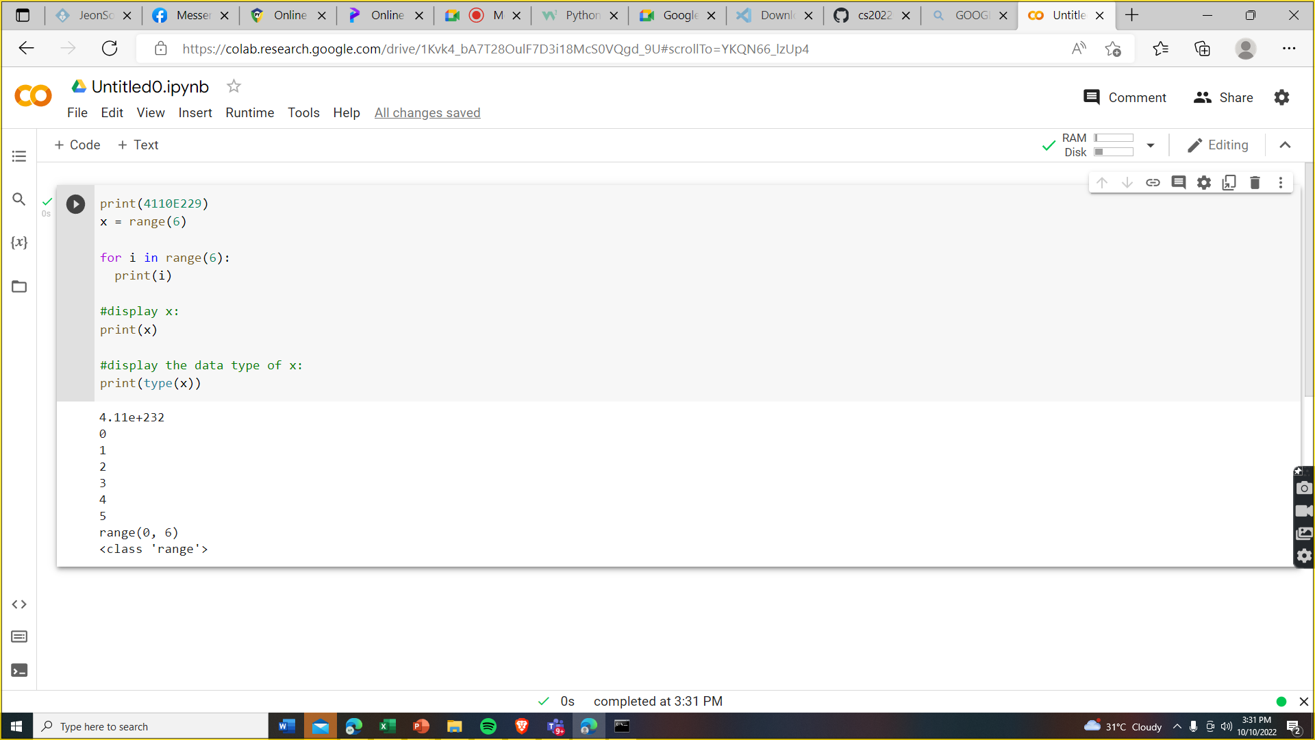
PYTHON DATA

Slide 13

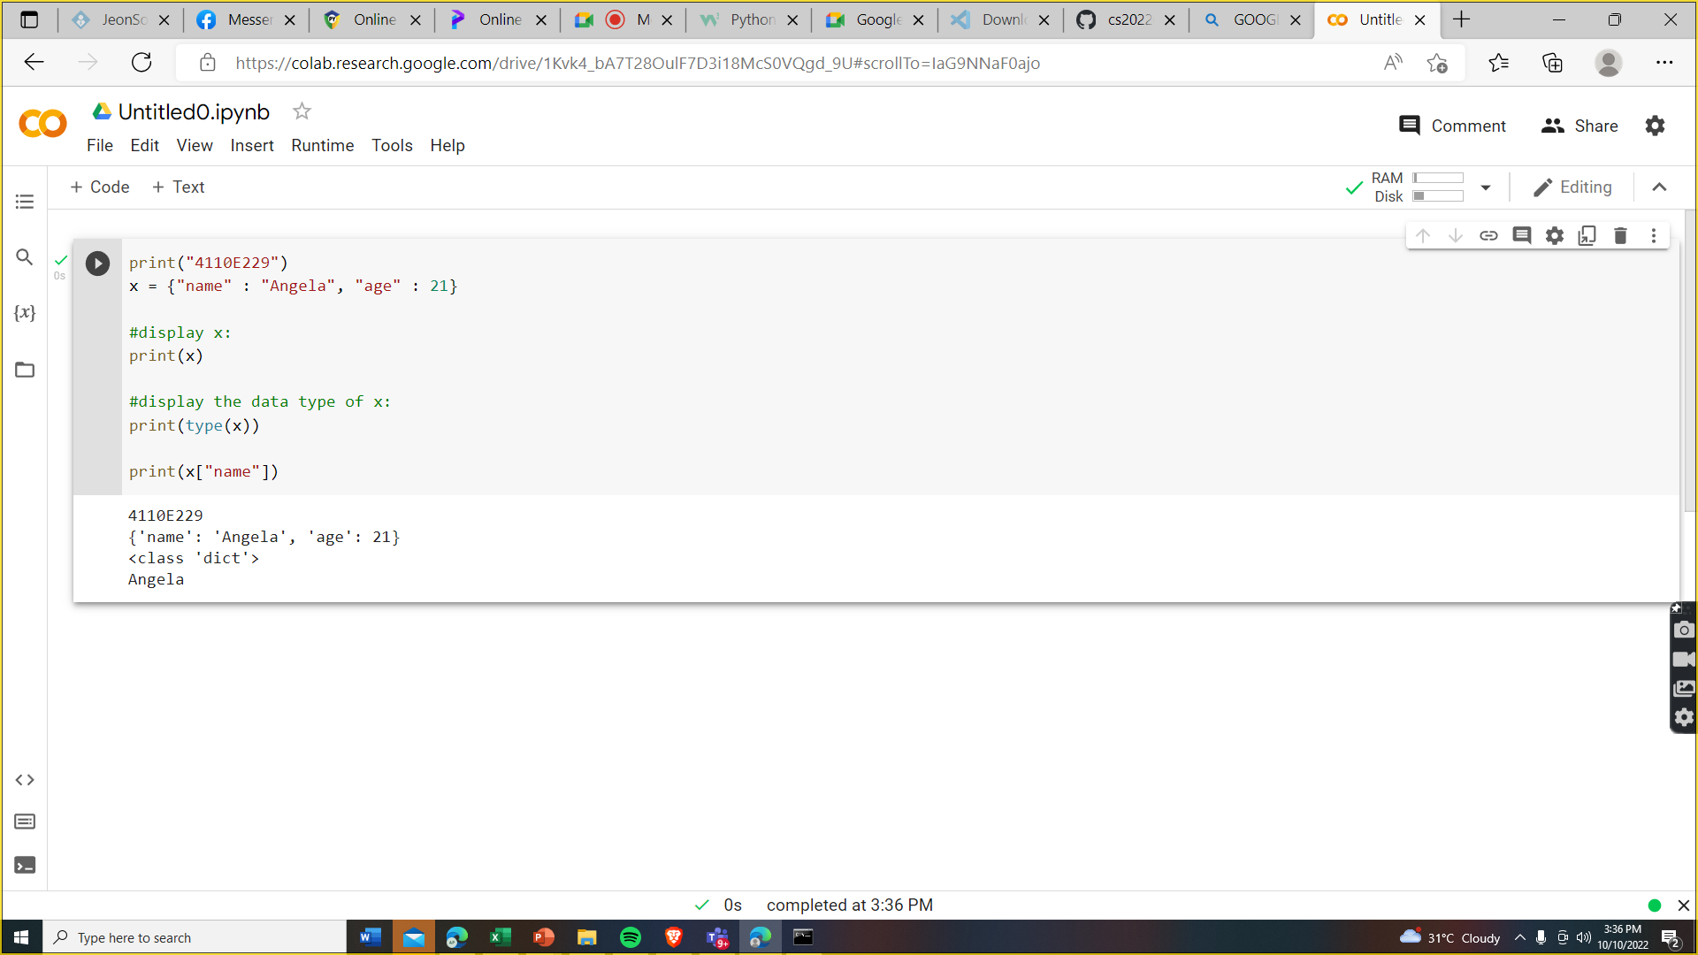
DICT: Key Value Pair

Slide 14
PYTHON OPERATORS

Slide 15
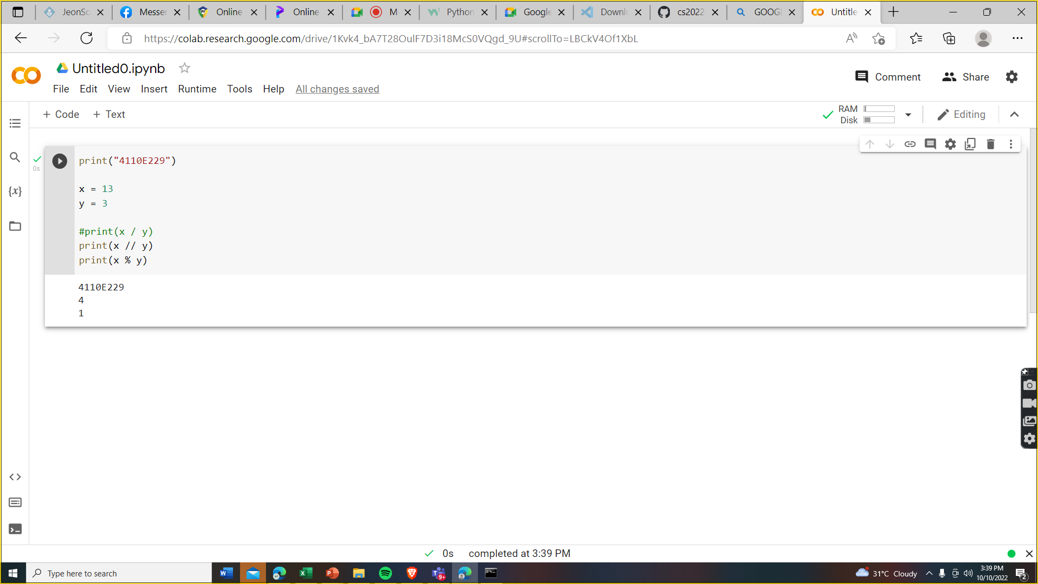
Python Arithmetic Operators:

Slide 16
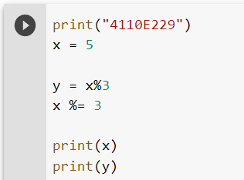
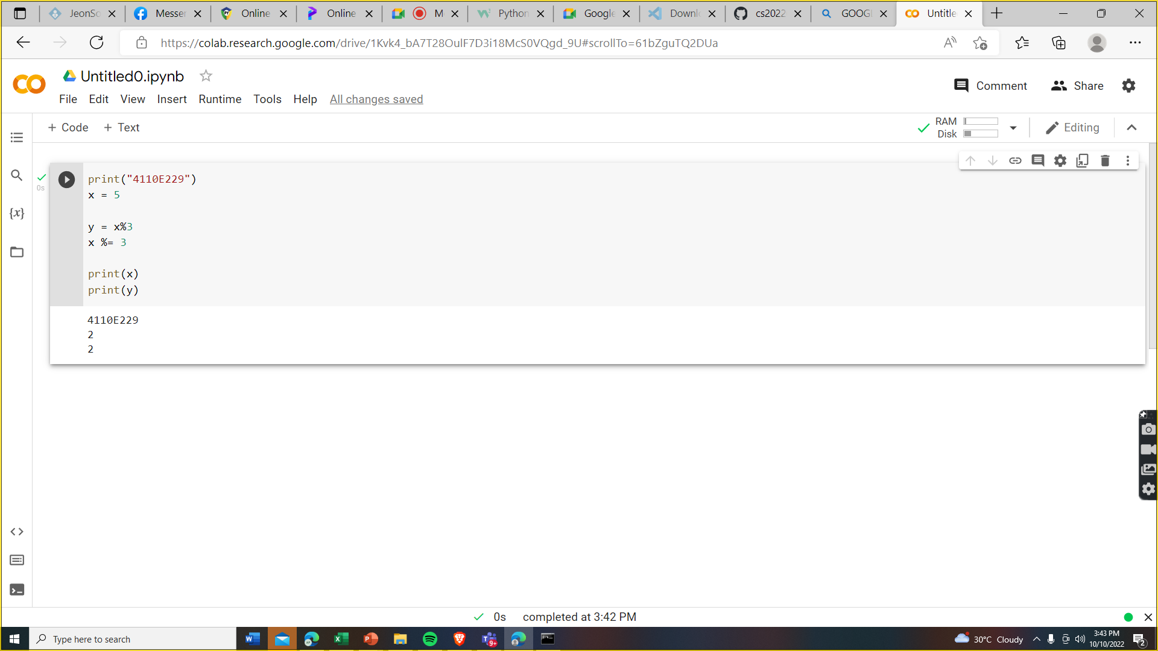
Python ASSIGNMENT Operators:
Python Assignment Operators

Slide 17
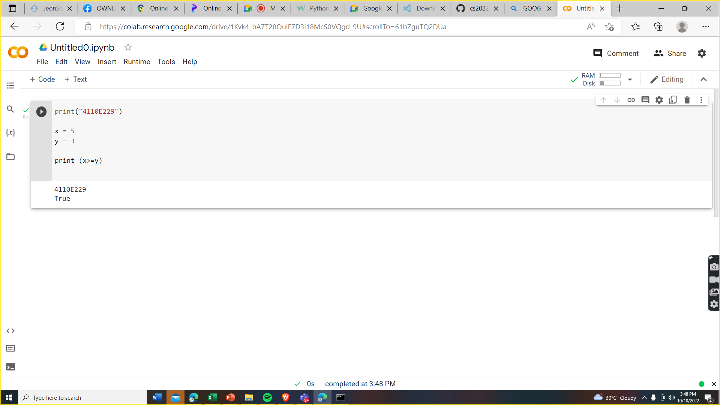
Python COMPARISON Operators:
Python Assignment Operators

Slide 18

Python LOGICAL Operators:
Python Assignment Operators

Slide 19

Python BITEWISE Operators:
Python Assignment Operators

Slide 20
MY PROFILE
CHINESE NAME: 安希佐
STUDENT ID: 4110E229
ENGLISH NAME: Angela Mae E. Pologon
NICKNAME: Gela
Email: angelamae.pologon@gmail.com
GITHUB: https://github.com/Gela21
See You Next Time!
Thank You

